Slide 1

Predicting Store Sales
Nur Azizah
Linkedin: https://www.linkedin.com/in/nur-azizah-2a5233139/
Github: https://github.com/azizah717
Tableau Public: https://public.tableau.com/app/profile/nur.azizah5048

Slide 2




Summary
Objective of Analysis
Business Solution
Data Introduction
Result of Analysis

Slide 3

Data Introduction
The data used for this analysis is Store Sales “Favorita” in Ecuador. In Ecuador, Favorita is one of the largest grocery chains.
As an oil-dependent country, Ecuador's economy is highly sensitive to oil price fluctuations. Shipping products to grocery stores throughout the country affects inventory, and therefore sales.
Source Data:
https://www.kaggle.com/competitions/store- sales-time-series-forecasting/data
(train, sample_submission, stores, oil, holidays_event)

Slide 4

Data Definition
Store_nbr identifies the store at which the products are sold.
Family identifies the type of product sold.
Sales gives the total sales for a product family at a particular store at a given date
Onpromotion gives the total number of items in a product family that were being promoted at a store at a given date.
Cluster is a grouping of similar stores.
Dcoilwtico oil price

Slide 5

Objective of Analysis
Deep Dive Analysis
How the growth of sales, product available on promotion and oilprice in monthly basis?
How the correlation between sales, onpromotion, and oilprice is calculated in a monthly basis?
When do sales have greatest impact?
Who are the top biggest customers?
Which cities are growing the most?
Exploratory Data Analysis
Descriptive & Univariat Analysis
Multivariate Analysis

Slide 6

Dataset Information
This project uses the following combined dataset:
Transaction start from 1st Jan 2013 till 15th Aug 2017
Event data start from 2nd Mar 2012 till 26th Dec 2017
Oil price data start form 1st Jan 2013 till 31st Aug 2017
Train data start from 1st Jan 2013 till 15th Aug 2017
The dataset consist of:
3027618 rows &13 features
Process
Handling missing value on feature Dcoilwtico using median price
One hot encoding for Modelling dataset
Handling outliers using clipping method
Split Data
Therefore, 1st Jan 2013 to 31st Jul 2017 was the date range used.
After combining & Filtering

Slide 7
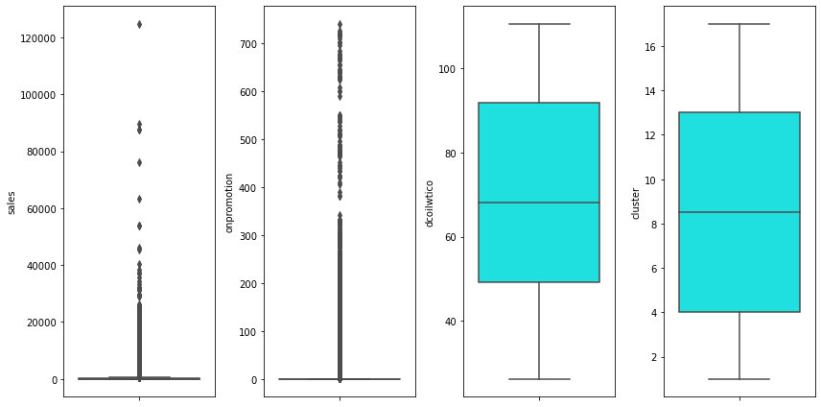
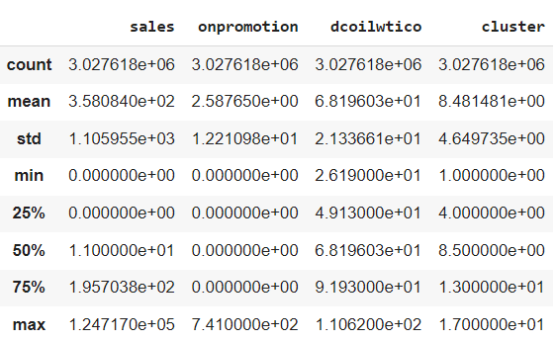
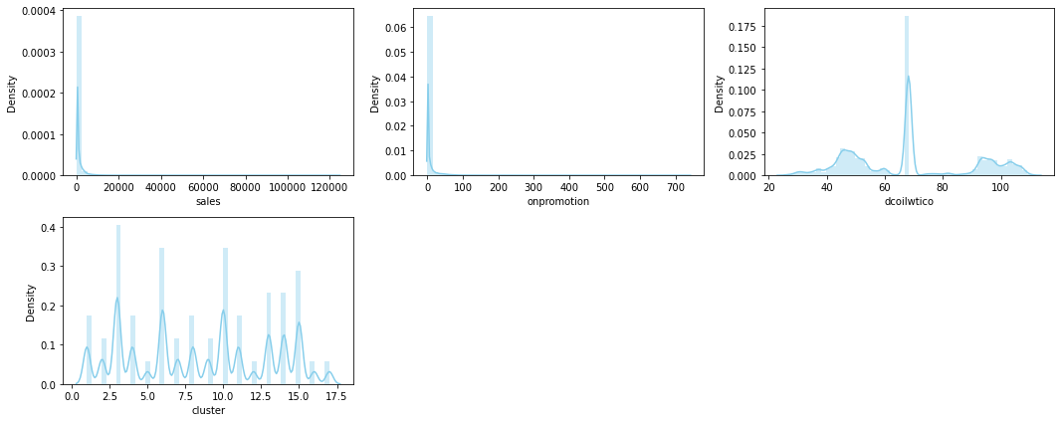
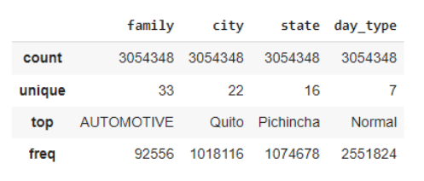
Descriptive & Univariate Analysis
Descriptive Statistics
Univariate Analysis
Numerical Features
Categorical Features
Sales and onpromotion not indicating a symmetrical distribution by looking at the mean-median difference
Dcoilwtico and cluster indicating a symmetrical distribution
The values of family, city, state, and day_type are unique
Except for sales and onpromotion, there are no outliers in store_nbr, dcoilwtico, or cluster. The data distribution of sales and onpromotion is not symmetric and there are many outliers.

Slide 8
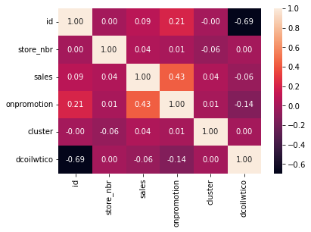
Multivariate Analysis
Heatmap Correlation
The largest correlation plot for sales and promotion characteristics is shown with probability = 0.43. This shows that both are positively related and that sales increase with more products advertised.

Slide 9
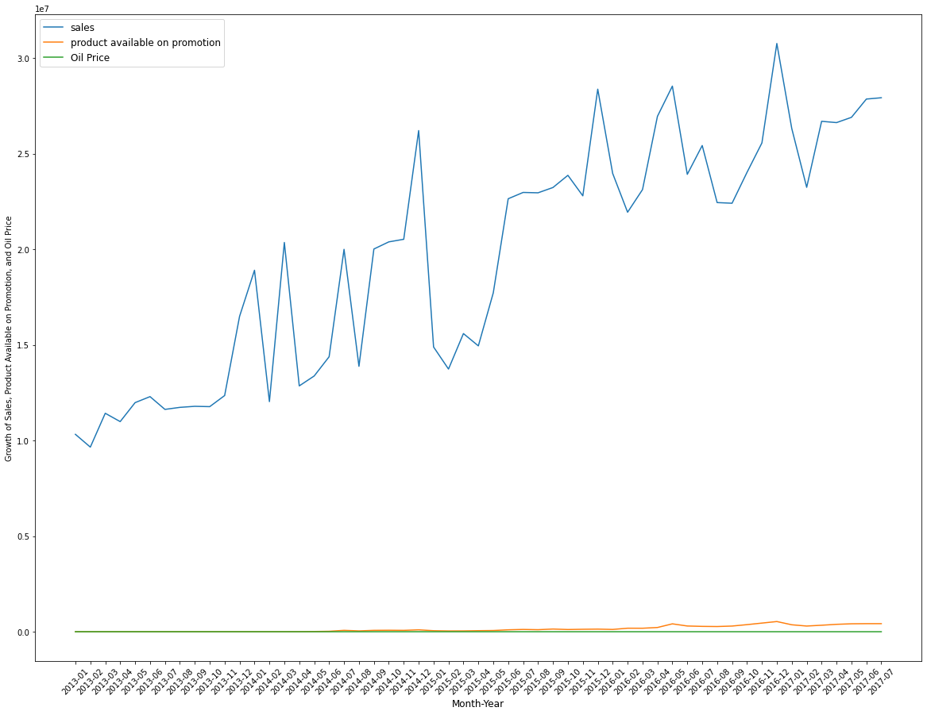
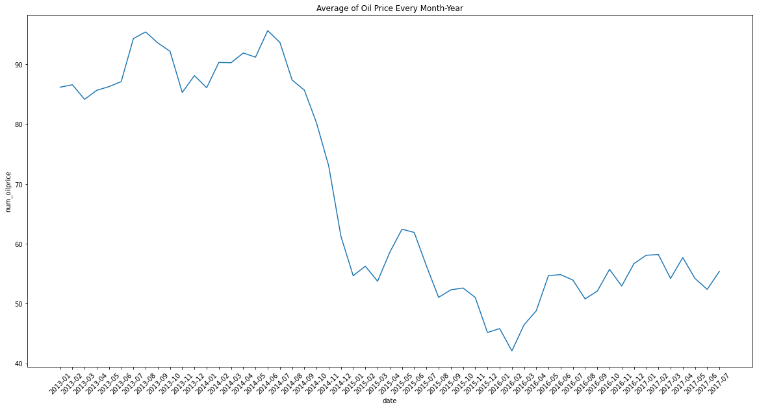
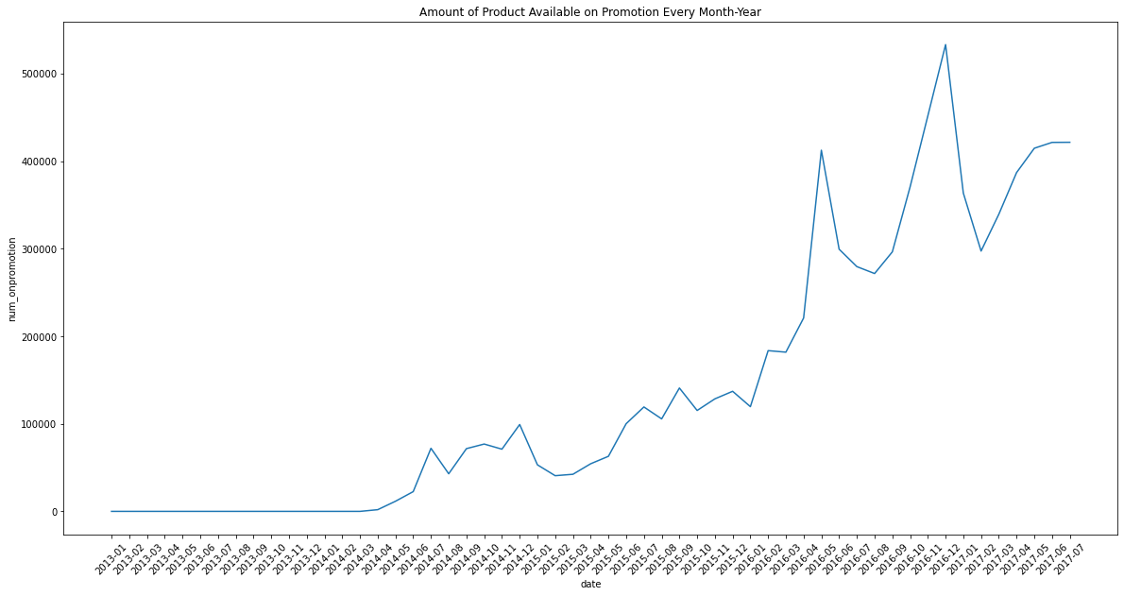
Result of Analysis
How the growth of sales, product available on promotion and oilprice in monthly basis?
Sales vs Product & Promotion
1
Detail from oil price.
Detail from the total number of items in a product family that were being promoted at a store at a given date.
Conclusion:
Due to promotions and oil prices there is a large difference in sales volume compared to solid product available but overall sales increased from January 2013 to July 2017. This coincides with the increase in production available for promotion and the drop in oil prices that really characterizes Ecuador that sensitive to oil prices.
1

Slide 10
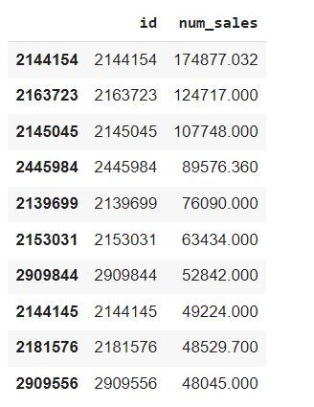
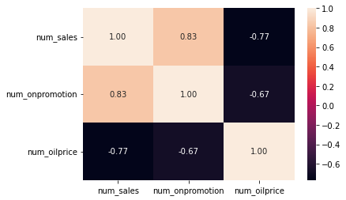
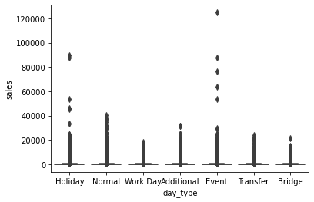
Result of Analysis
How the correlation between sales, onpromotion, and oilprice is calculated in a monthly basis?
Who are the top biggest customers?
4
2
When do sales have greatest impact?
3
Conclusion:
2
Promotion is positively correlated to sales, while oil prices are negatively correlated to sales with a strong correlation. Sales with the highest consistency figures are on normal days. Whereas at events & holidays there are outliers where this is possible because of customer behavior
The customer with that ID is the customer with the highest number of purchases
3
4

Slide 11
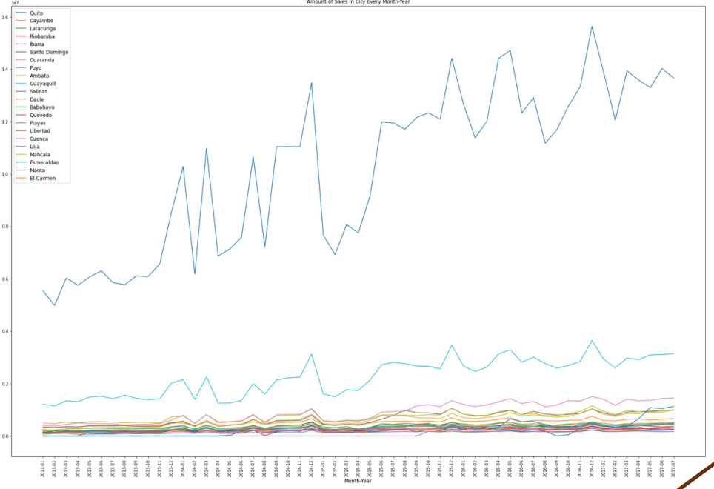
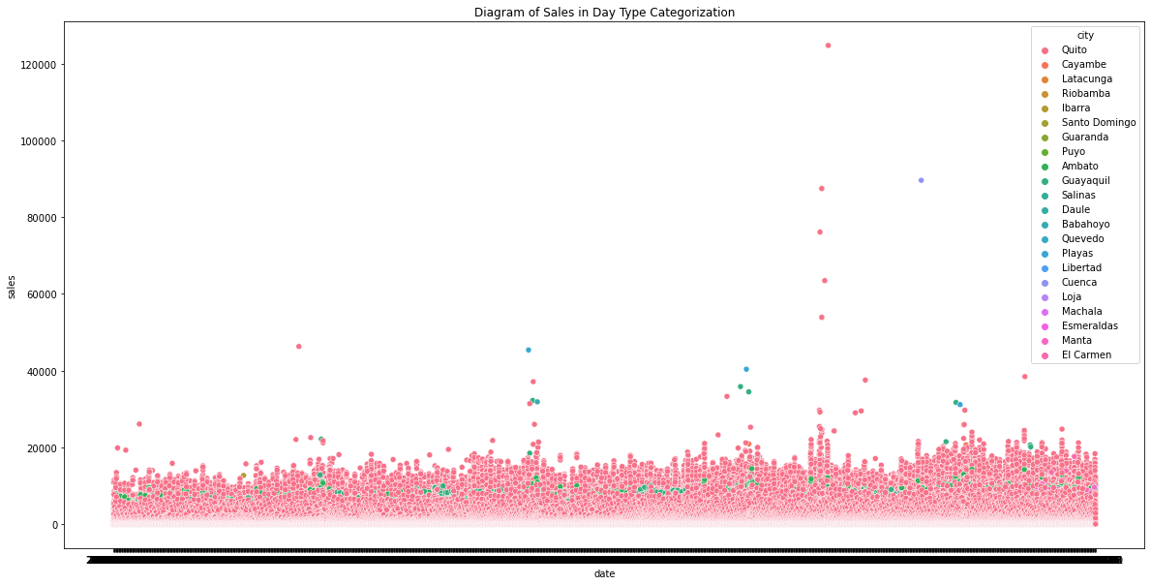
Result of Analysis
Which cities are growing the most?
5
5
According to the result graph from a conventional EDA, Quito has the highest sales, hence Quito is clearly the market leader in terms of sales.

Slide 12
Model Prediction
Result of Hyperparameter Tuning and applied best paramaters on Test Data
Model Forecasting | Parameters | RMSE* | MAE** | R2*** | Result
Ridge Regression | Alpha=10 | 121.623 | 91.948 | 55,545 | Declined
Lasso Regression | Alpha=0.0001 | 121.623 | 91.94 | 55,545% | Declined
Random Forest | Max_depth=10, min_samples=4, n_estimator=15 | 53.265 | 22.224 | 91,472% | Declined
XGBoost | Learning_rate=0.5, max_depth=10, n_estimatord=15 | 35.016 | 14.184 | 96,521% | Accepted

Slide 13
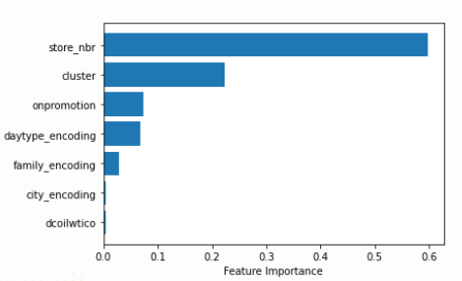
XGBoost
Features Importance
The location of the stores has significant impact to the sales amount
The RMSE, MAE, and R-squared of the train and test data are not significantly different, indicating that the XGB Boost model fits the data well.
R-squared = 96,521% demonstrates that 96,521% of independent variables can account for the volume of sales (dependent variables). Additionally, 3,479% more are explained by other factors.

Slide 14
Business Solution
To cut costs, the supply chain's delivery and allocation processes must be efficient.
2. Creating a discount scheme.
Discount scheme based on client loyalty cards
A recurring discount program for any goods
3. Increase soft marketing and digital marketing efforts to connect with customers and potential purchasers.

Slide 15

THANK YOU

